Slide 1
Slides for City Council meeting of January 9, 2019
Mark Graham

Slide 2
Is long term exposure to non-ionzing electromagnetic fields hazardous to human health?
Let’s see what AT&T and Verizon say about this in their insurance documents, in particular their exclusions from coverage.

Slide 3
Damage from pollutants:
Verizon and ATT’s own mobile device insurance does not include coverage for emission of Pollutants which they clearly define Wireless Radiation by all its names (EMF, electromagnetic fields, microwaves, non-ionizing radiation) as a pollutant actually in greater detail than any of the other pollutants.
See direct quotations from their current insurance documents as of 10-14-18.
Emphasis is added in these quotations.

Slide 5
Excerpts from page 5 of this Verizon brochure
B. EXCLUSIONS
2. This insurance does not apply to loss or damage caused by or resulting from any of the following:
m. Pollution The discharge, dispersal, seepage, migration, escape or presence of pollutants. Pollutants means any solid, liquid, gaseous, or thermal irritant or contaminant including smoke, vapor, soot, fumes, acid, alkalis, chemicals, artifcially produced electric felds, magnetic feld, electromagnetic feld, sounds waves, microwaves, all artifcially produced ionizing or non-ionizing radiation and/or waste. Waste includes materials to be recycled, refurbished or reclaimed.
(emphasis added)

Slide 6
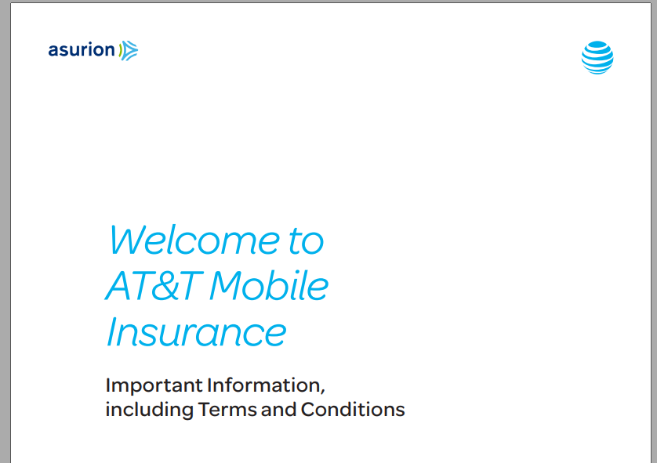

Slide 7
Excerpts from pages 7 and 14 of this AT&T brochure
II. EXCLUSIONS
H. Loss caused by or resulting from the discharge, dispersal, seepage, migration, release or escape of Pollutants
P. “Pollutants” means: Any solid, liquid, gaseous, or thermal irritant or contaminant including smoke, vapor, soot, fumes, acid, alkalis, chemicals, artificially produced electric fields, magnetic field, electromagnetic field, electromagnetic pulse, sound waves, microwaves, and all artificially produced ionizing or non-ionizing radiation and waste. Waste includes materials to be recycled, reconditioned or reclaimed.

